Slide 1
Project Gladiator (Embedded Track)
Group 4

Slide 2
Multi-Source Live Video Streaming System

Slide 3
INTRODUCTION
The project is to read video and convert raw video frames from different source like camera, drones, web camera and pass those frames for processing like color inversion, resolution adjustment, then encoding and compression of the frames and using sockets to pass all the videos to server. In different modules using synchronization between multiple threads and using IPCs.

Slide 4
Scope
The real-time system for handling live video streams during a live event encompasses a comprehensive set of functionalities and features to ensure a seamless and immersive viewing experience. The scope of the system includes:
Support integration with various video sources, including cameras and drones, to capture diverse perspectives of the live event.
Implement protocols for establishing a reliable connection with each video source and managing the incoming streams.
Develop a mechanism for efficiently sharing video frames among different processing modules in real-time.

Slide 5
Video Frame Acquisition:
The first step in project is to convert different video sources to frames. This is done using ffmpeg.
ffmpeg is a very fast video and audio converter that can also grab from a live audio/video source. It can also convert between arbitrary sample rates and resize video on the fly with a high-quality filter.
ffmpeg reads from an arbitrary number of input ``files'' (which can be regular files, pipes, network streams, grabbing devices, etc.), specified by the "-i" option, and writes to an arbitrary number of output ``files'', which are specified by a plain output filename. Anything found on the command line which cannot be interpreted as an option is considered to be an output filename.

Slide 6
In the next step we used shared memory to store the raw video frames.
Inter Process Communication through shared memory is a concept where two or more process can access the common memory and communication is done via this shared memory where changes made by one process can be viewed by another process.

Slide 7

Color Inversion
After successfully reading the frames, we are changing the frames output videos color for that purpose, we used RGB – Red Green Blue values in frames to change the color of the frames.
The same ffmpeg library is used to read the frames here.

Slide 8
Resolution Adjustment
The program askes user to enter the height and width of the video and convert the of the video as per the user input.

Slide 9
Object detection
Here we used RGB colors to detect object and SDL library.
SDL is Simple Direct Media Layer. It is a cross-platform development library designed to provide low level access to audio, keyboard, mouse, joystick, and graphics hardware.It can be used to make animations and video games.
It basically provides a set of APIs to interact with various devices like graphics hardware, audio, keyboard, mouse, etc.
It is written in C programming language and works with C++ and various other languages like c# and python.

Slide 10

Encoding and compression
Encoding is the process of compressing and changing the format of raw video content to a digital file or format, which will in turn make the video content compatible for different devices and platforms. The main goal of encoding is to compress the content to take up less space.
Video compression is the process of reducing the number of bits needed to represent a video without compromising its visual quality.
The same is implemented using ffmpeg library

Slide 11
UDP Socket programming
In the last step we used UDP(User Datagram Protocol) client server socket to transfer the compressed video to server and display the videos for streaming for multiple users.

Slide 12
WHY UDP?
User Diagram Protocol (UDP) is a connectionless protocol that is located in between application layer and IP layer. It is mainly used for broadcasting messages over a network.​
UDP is chosen for its low overhead and simplicity.​
UDP often uses packets with small size and headers. Due to the presence of small headers, UDP protocols take very less time in processing the packets which ultimately requires less memory for operations.​
Connection Speed : UDPs are generally faster due to the absence of acknowledgement fields. Neither they do not need to wait on acknowledgement or hold the data on memory.​

Slide 13
UDP is widely used in online gaming, where low latency and high-speed communication is essential for a good gaming experience. Game servers often send small, frequent packets of data to clients, and UDP is well suited for this type of communication as it is fast and lightweight.
Streaming media applications, such as IPTV, online radio, and video conferencing, use UDP to transmit real-time audio and video data. The loss of some packets can be tolerated in these applications, as the data is continuously flowing and does not require retransmission.
VoIP (Voice over Internet Protocol) services, such as Skype and WhatsApp, use UDP for real-time voice communication. The delay in voice communication can be noticeable if packets are delayed due to congestion control, so UDP is used to ensure fast and efficient data transmission.
DNS (Domain Name System) also uses UDP for its query/response messages. DNS queries are typically small and require a quick response time, making UDP a suitable protocol for this application.
DHCP (Dynamic Host Configuration Protocol) uses UDP to dynamically assign IP addresses to devices on a network. DHCP messages are typically small, and the delay caused by packet loss or retransmission is generally not critical for this application.

Slide 14
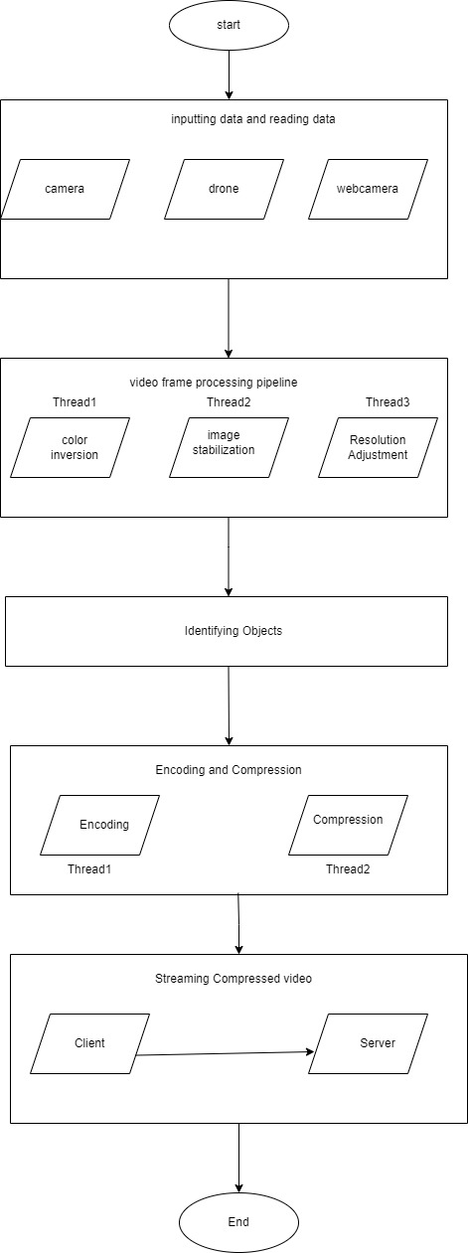
FLOW CHART

